Slide 1


Adjusted means and Adjusted proportions from regression (EMMEANS in R and LSMEANS/%Margins in SAS)
Jialiang Hua, Lydia Zhang and Dan Alschuler
Supervisor: Melanie Wall
Mental Health Data Science

Slide 2
Why do we want Adjusted Means (or Adjusted proportions)?
After fitting a regression model, it is often of interest present the adjusted means (or adjusted proportions) of the outcome of interest by the different categories of a primary categorical predictor variable after controlling for covariates
Y~N(mu, sigma^2)
mu = b0 + b1 Exposure + b2 Race + b3 Sex + b4 Age (Linear model with identity link scale)
Y~Bin(pi)
logit(pi) = log(pi/(1-pi)) = b0 + b1 Exposure + b2 Race + b3 Sex + b4 Age (Logistic model with logit link scale)
The expected means [E(Y|Exposure = 0, Race, Sex, Age) and E(Y|Exposure = 1, Race, Sex, Age)] help facilitate interpretation of the results comparing groups AFTER control for covariates.
LSMEANS – “Least Squares Means” AND %Margins Macro in SAS
EMMEANS – “Estimated marginal means” in R
Issues
What should the distribution of the covariates (eg. Race, Sex, Age) be fixed to when taking the expectation
What scale should expectation be taken on? <- logit or probability - relevant for logistic not linear model.

Slide 3
EMMEANS package in R
Last updated 10-17-2023 Russell V. Lenth [aut, cre, cph], Ben Bolker [ctb], Paul Buerkner [ctb], Iago Giné-Vázquez [ctb], Maxime Herve [ctb], Maarten Jung [ctb], Jonathon Love [ctb], Fernando Miguez [ctb], Hannes Riebl [ctb], Henrik Singmann [ctb]

Slide 4
Background/Introduction
Estimated marginal means (EMMs) are defined as marginal means of model predictions over the grid comprising all factor combinations (the reference grid).
The underpinnings of estimated marginal means – and much of what the emmeans package offers – relate more to experimental data than to observational data.

Slide 5
Background/Introduction
1. Experimental vs. Observational Data
Observational Data: Sample from a population to characterize it.
Experimental Data: Control the environment, observe outcomes. The population is abstract, defined by enforced conditions.
2. Default Behavior of emmeans()
Averages groups with equal weights for all factor levels of categorical covariates
More common in experimental data analysis, but not common in observational data analysis.
lead to misunderstandings and thus some criticisms.

Slide 6
Weights options in emmeans – specifies distribution of categorical covariates, continuous covariates are fixed at their observed means
weights = "equal" weights covariates equally across all factor combinations (the default and the default in LSMEANS in SAS).
weights = "proportional" weights the joint distribution of other covariate factors fixed at OBSERVED joint distribution. Most commonly used in our work. Similar to LSMEANS /OM option in SAS.
weights = "outer" weights in proportion to each individual factor's marginal frequencies. The weights for a combination of factors are the outer product of the one-factor margins.
weights = "cells" weights according to the frequencies of the cells being averaged within each level of factor. Results in unadjusted means for categorical covariates. When there are only continuous covariates, they are adjusted.

Slide 7
Example dataset
Example dataset: effects of dietary protein on free plasma leucine concentration in pigs (n=29) [from emmeans package]
Predictors
source: primary predictor of interest. Protein source in the diet (binary: skim (dried skim milk) and non-skim)
percent: protein percentage in the diet (4 categorical values: 9, 12, 15, 18)
x: randomly generated continuous predictor variable
dich: randomly chosen dichotomous predictor variable
Outcome
conc: the continuous outcome: concentration of free plasma leucine, in mcg/ml
CONC = b0 + b1 * source + b2 * factor(percent) + b3 * x + b4 * factor(dich) + e
Notes:
We modified a dataset in the emmeans package to get our test dataset.

Slide 8
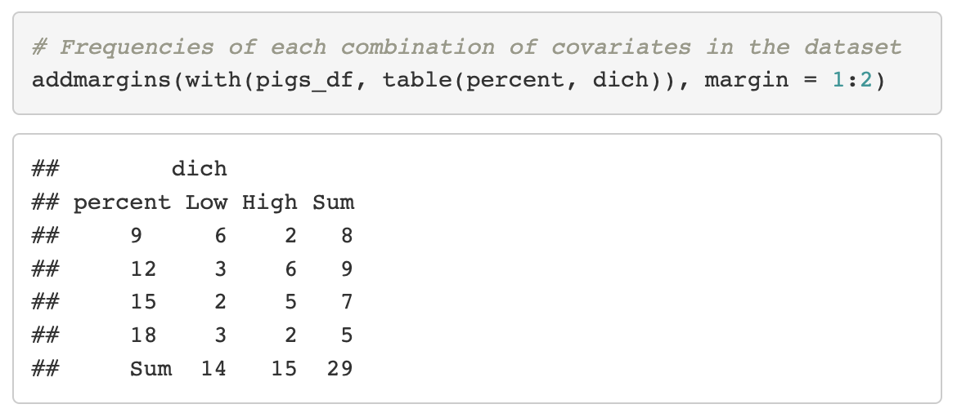
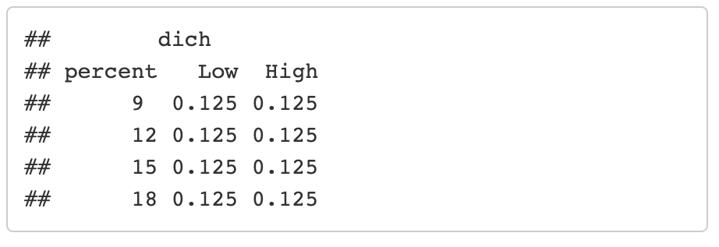
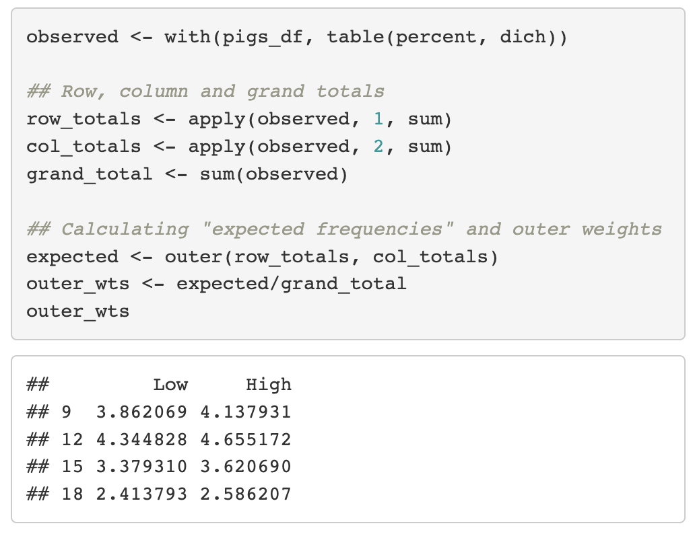
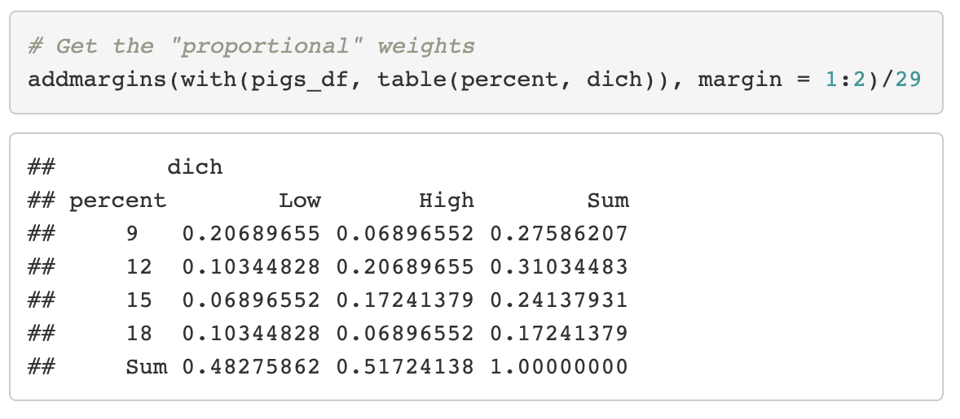
Weights options in emmeans
Weights = …… are for categorical covariates.
weights = “equal”
observed joint distribution of covariates
weights = “proportional”
weights = “outer”

Slide 9
EMMEANS are different for different Weights
 |  |  | Estimates |  |  |  | Contrasts
Model | Weights | source | Estimate | SE | CI lower | CI upper | Estimate | SE | CI lower | CI upper | P
conc ~ source + x + factor(percent) + dich | equal | skim | 40.4251 | 0.5131 | 39.3610 | 41.4893 | 4.1633 | 0.6249 | 2.8672 | 5.4594 | <.0001
conc ~ source + x + factor(percent) + dich | equal | non-skim | 36.2618 | 0.3184 | 35.6015 | 36.9221
conc ~ source + x + factor(percent) + dich | proportional | skim | 40.2609 | 0.5004 | 39.2231 | 41.2987 | 4.1633 | 0.6249 | 2.8672 | 5.4594 | <.0001
conc ~ source + x + factor(percent) + dich | proportional | non-skim | 36.0976 | 0.3198 | 35.4344 | 36.7608
conc ~ source + x + factor(percent) + dich | outer | skim | 40.2609 | 0.5004 | 39.2231 | 41.2987 | 4.1633 | 0.6249 | 2.8672 | 5.4594 | <.0001
conc ~ source + x + factor(percent) + dich | outer | non-skim | 36.0976 | 0.3198 | 35.4344 | 36.7608
Contrast the SAME for all

Slide 10
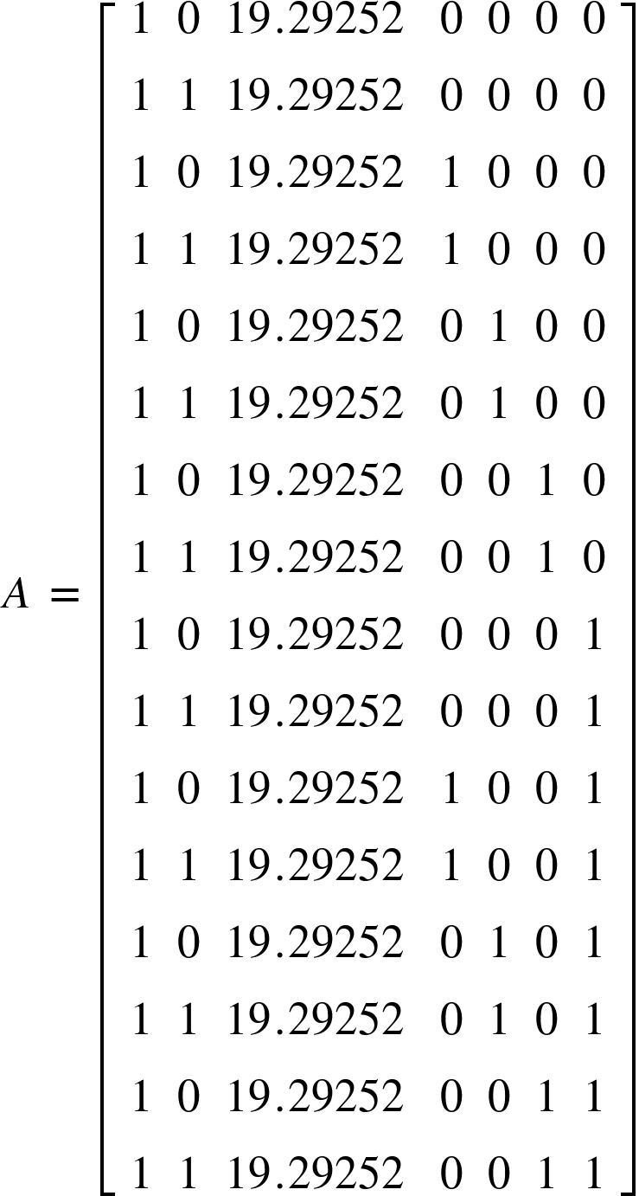
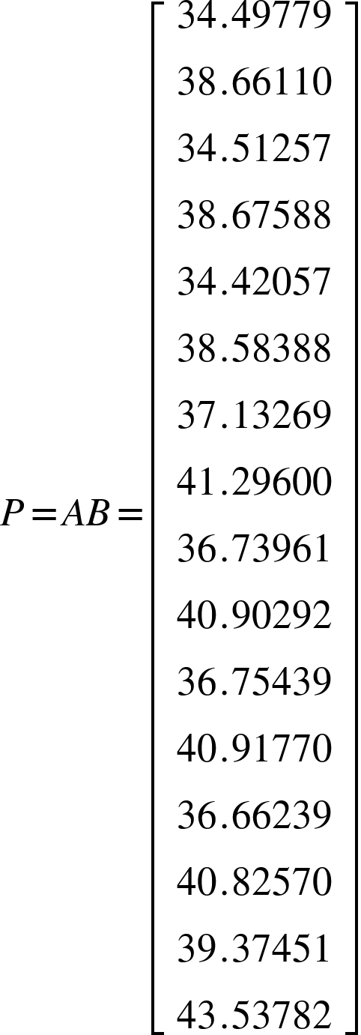
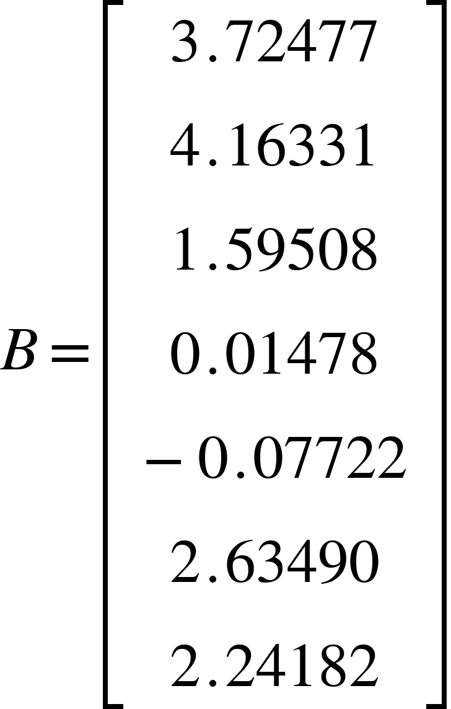
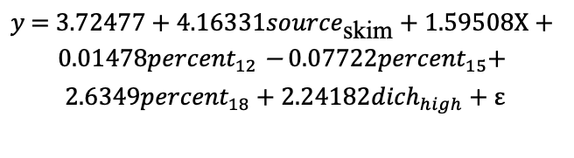
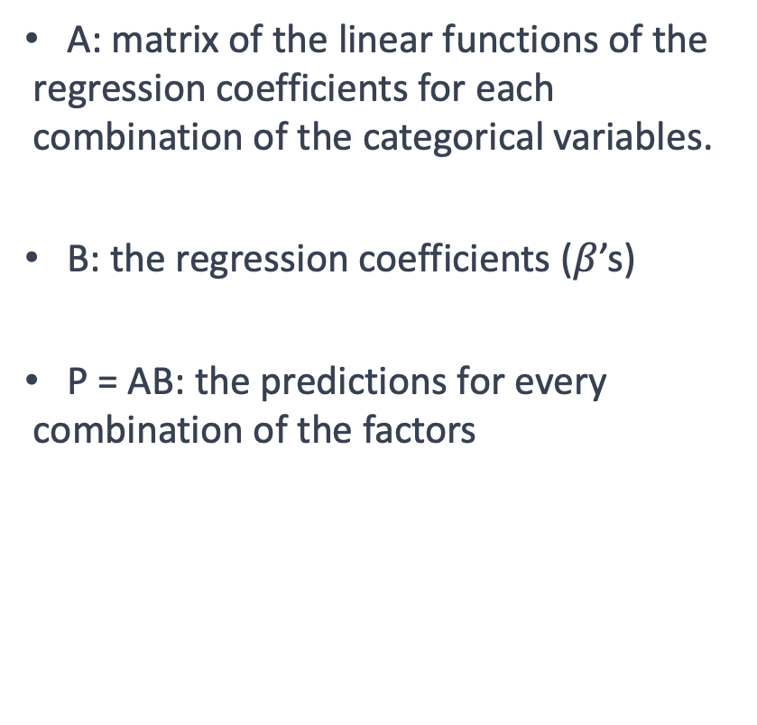
Predicted values for all combinations
sourceSkim
percent12
A: matrix of the linear functions of the regression coefficients for each combination of the categorical variables.
B: the regression coefficients ($β$’s)
P = AB: the predictions for every combination of the factors
percent18
Intercept
x
percent15
dichHigh
$$y\text{ = 3.72477 + 4.16331}{source}_{\text{skim}}\text{ + 1.59508}\text{X}\text{ + 0.01478}{percent}_{12} \text{−}\text{ 0.07722}{percent}_{15}\text{+ 2.6349}{percent}_{18}\text{ + 2.24182}{dich}_{high}\text{ + }\text{ε}$$

Slide 11
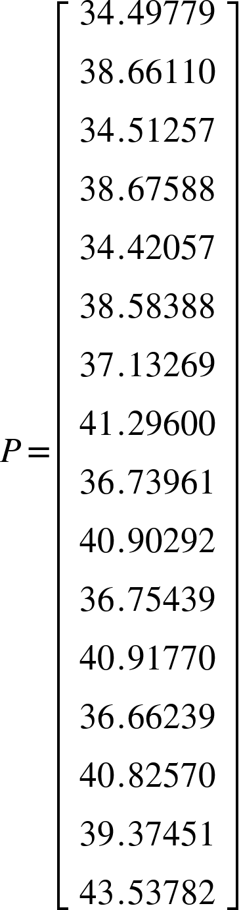
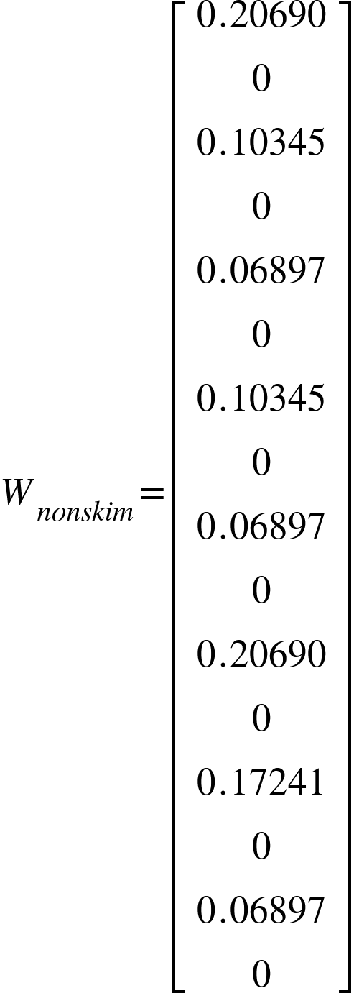
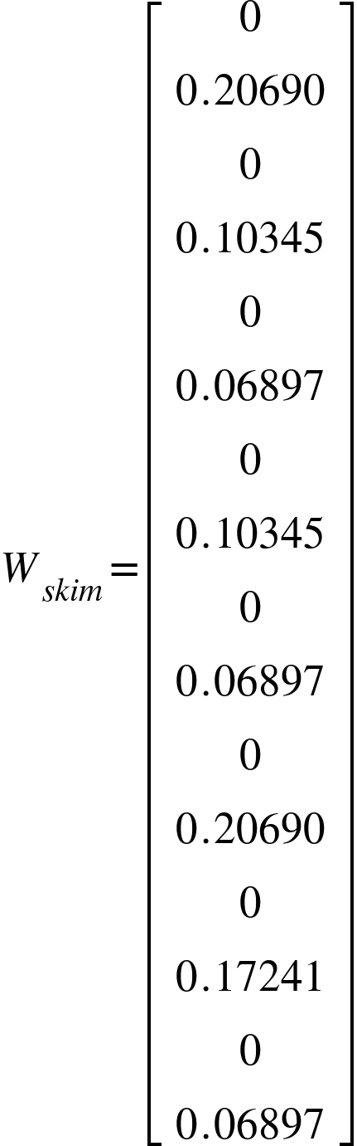
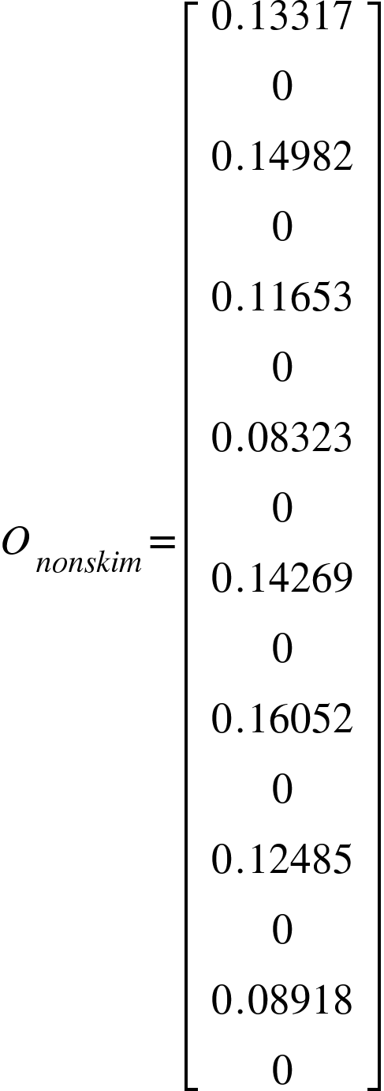
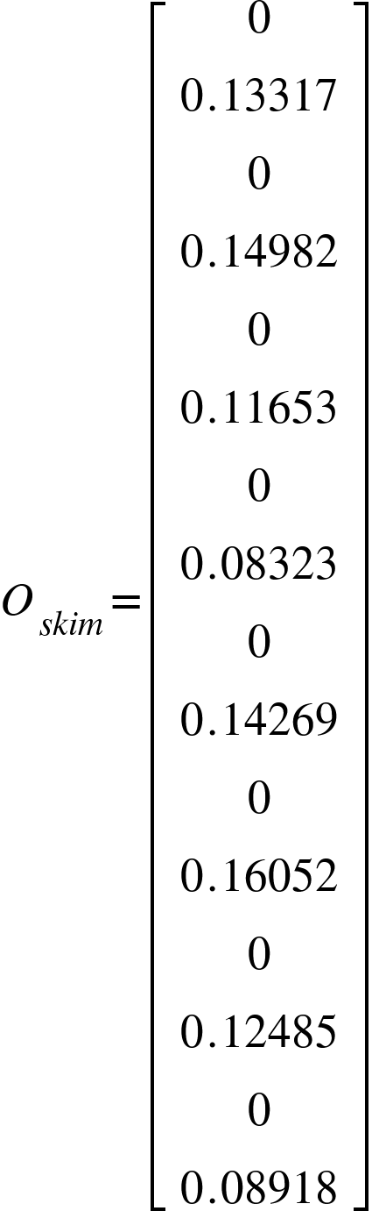
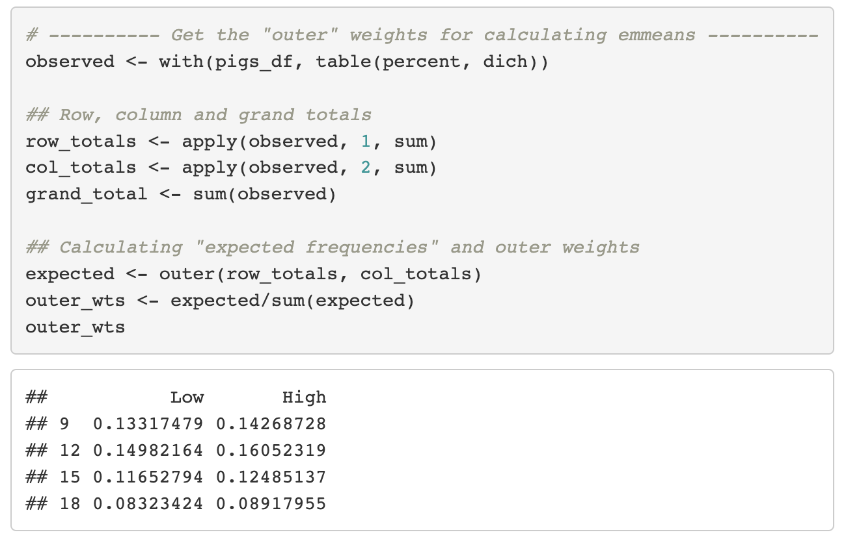
Weights = "proportional" vs "outer"
weights = "proportional"
weights = “proportional”
weights = "outer" :
weights = “outer”

Slide 12
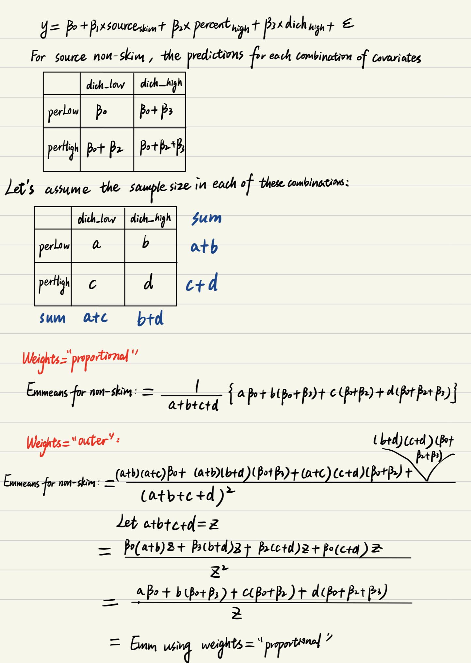
Weights = "proportional" vs "outer"
In the case of linear model without interactions, we can prove emmeans obtained using weights=“proportional” and weights=“outer” are the same. To make life easier, let’s simplify the model to one with 1 binary primary predictor and 2 binary covariates: $y= β_{0}+ β_{1}∙{source}_{skim}+ β_{2}∙percent_{high}+β_{3}∙dich_{high}+ε$

Slide 13
Weights = "proportional" vs "outer” in presence of an interaction
 |  |  | Estimates |  |  |  | Contrasts
Model | Weights | source | Estimate | SE | CI lower | CI upper | Estimate | SE | CI lower | CI upper | P
conc ~ source + x + factor(percent)*dich | equal | skim | 40.2501 | 0.5578 | 39.0827 | 41.4176 | 4.0800 | 0.6518 | 2.7158 | 5.4443 | <.0001
conc ~ source + x + factor(percent)*dich | equal | non-skim | 36.1701 | 0.3393 | 35.4599 | 36.8803
conc ~ source + x + factor(percent)*dich | proportional | skim | 40.2035 | 0.5202 | 39.1148 | 41.2922 | 4.0800 | 0.6518 | 2.7158 | 5.4443 | <.0001
conc ~ source + x + factor(percent)*dich | proportional | non-skim | 36.1234 | 0.3308 | 35.4311 | 36.8157
conc ~ source + x + factor(percent)*dich | outer | skim | 40.0773 | 0.5471 | 38.9322 | 41.2224 | 4.0800 | 0.6518 | 2.7158 | 5.4443 | <.0001
conc ~ source + x + factor(percent)*dich | outer | non-skim | 35.9973 | 0.3409 | 35.2837 | 36.7108
Now outer and proportion are not the same for their EMMEANS but contrast is the same

Slide 14
Summary of weights (distribution of categorical covariates)
In linear models without interactions, emmeans obtained using weights=“proportional” and weights=“outer” are the same.
The different weighting options (equal, proportional, outer) do not affect the contrasts and p values.
We should use weights=“proportional” for most of cases in our work.
We might consider using weights=“outer” when we want to standardize the EMMs to a population where the covariates are uncorrelated.

Slide 15
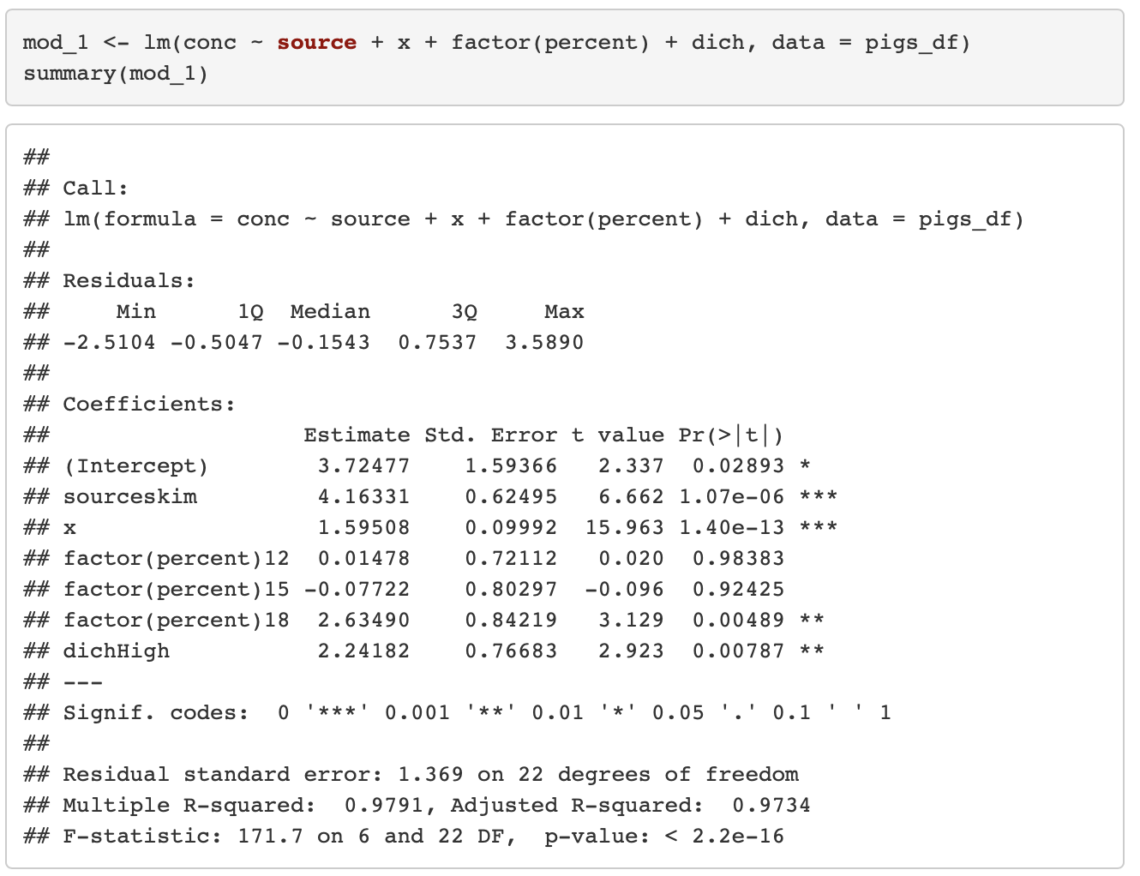
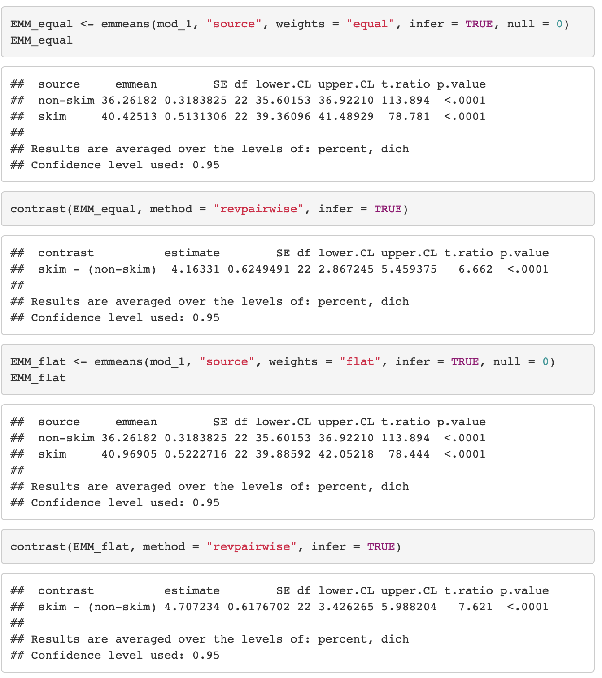
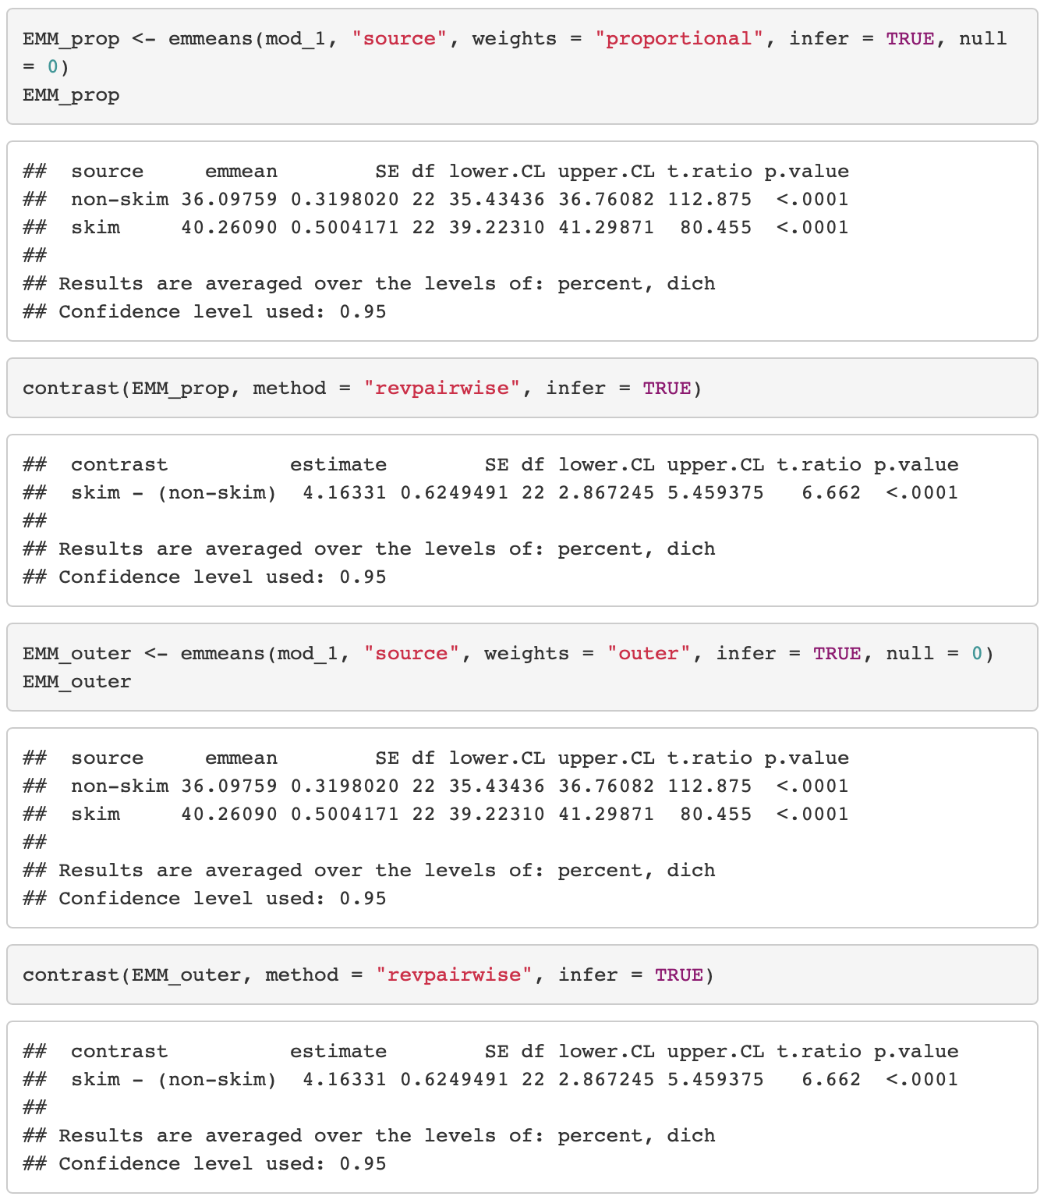
R code – linear model (identity link) without interactions

Slide 16
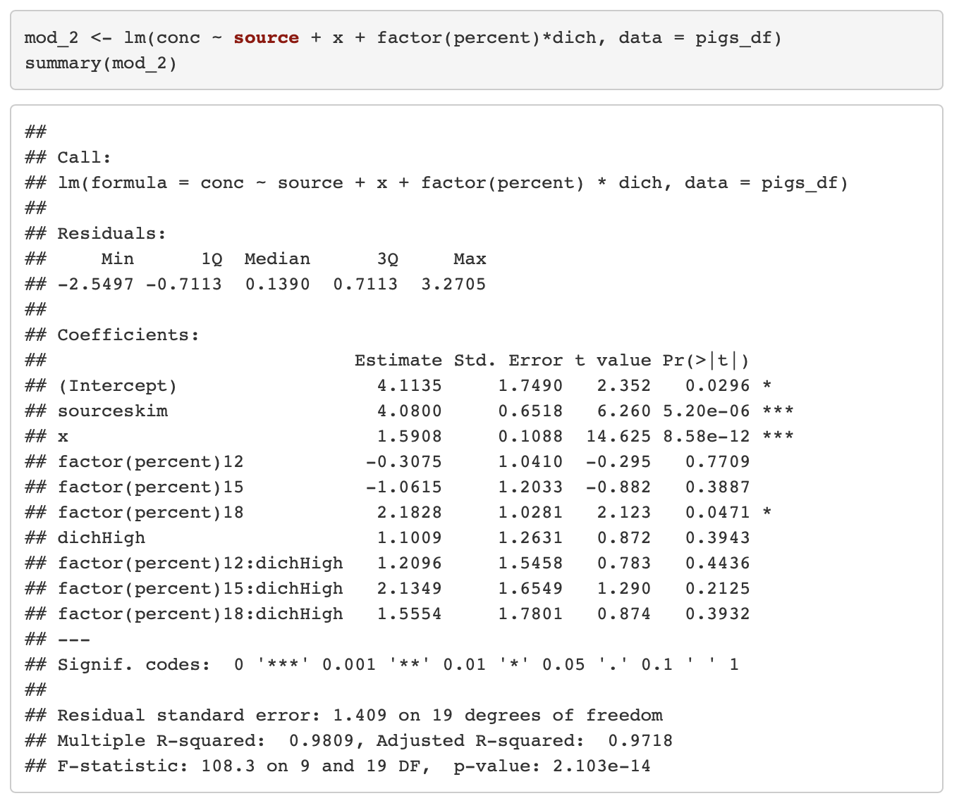
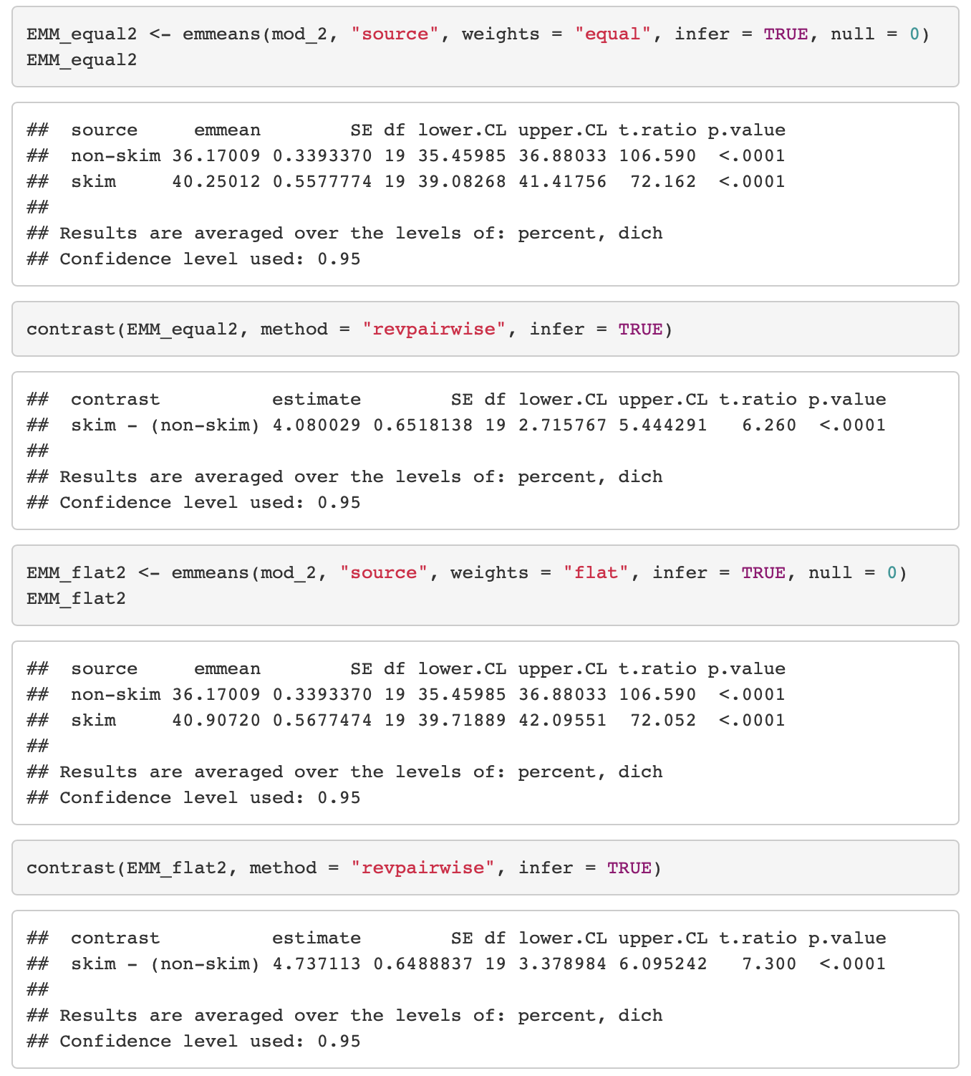
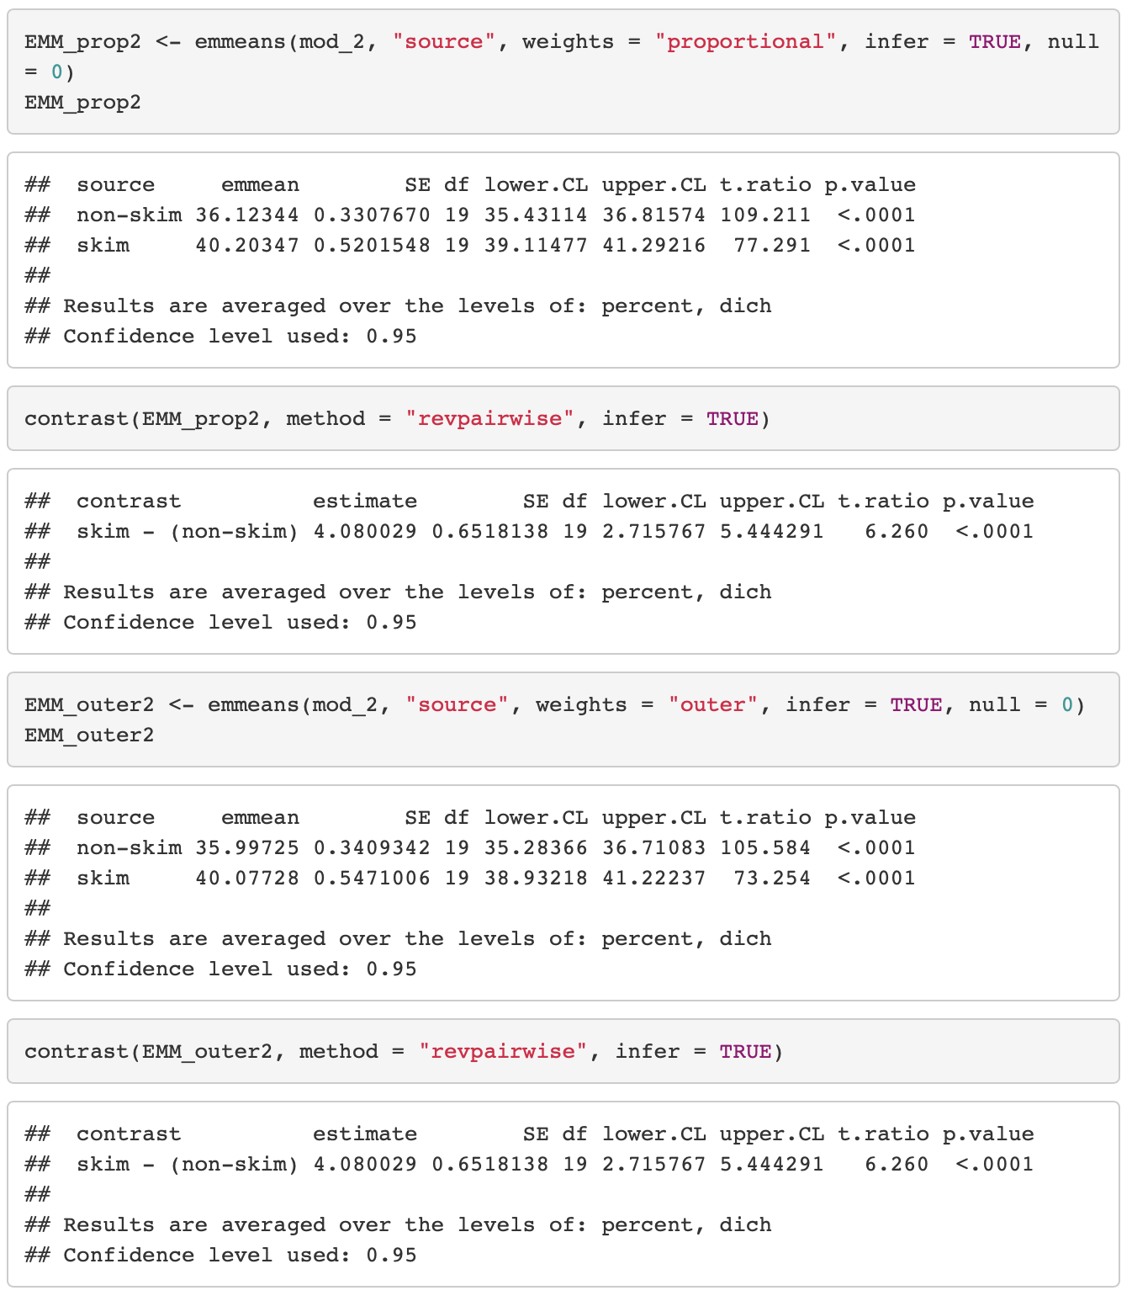
R code – linear model (identity link) with interactions

Slide 17
Adjusted Proportions – Expected means with dichotomous outcomes
Issues
Getting Expected means on the logit scale – easy to do, not easy to interpret
Getting Expected means on the probability scale – two different quantities
Take the mean on logit scale with mean of covariates, then backtransform to probability scale
Backtransform to probability scale for some values of covariates, then take the mean on the probability scale

Slide 18
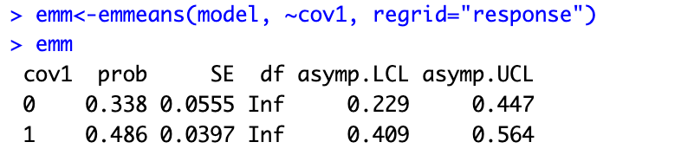
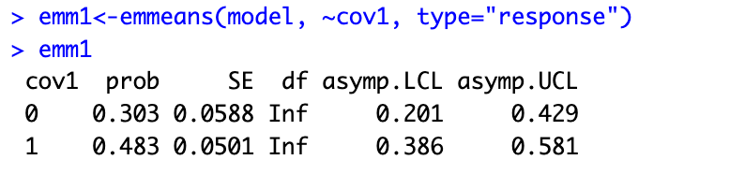
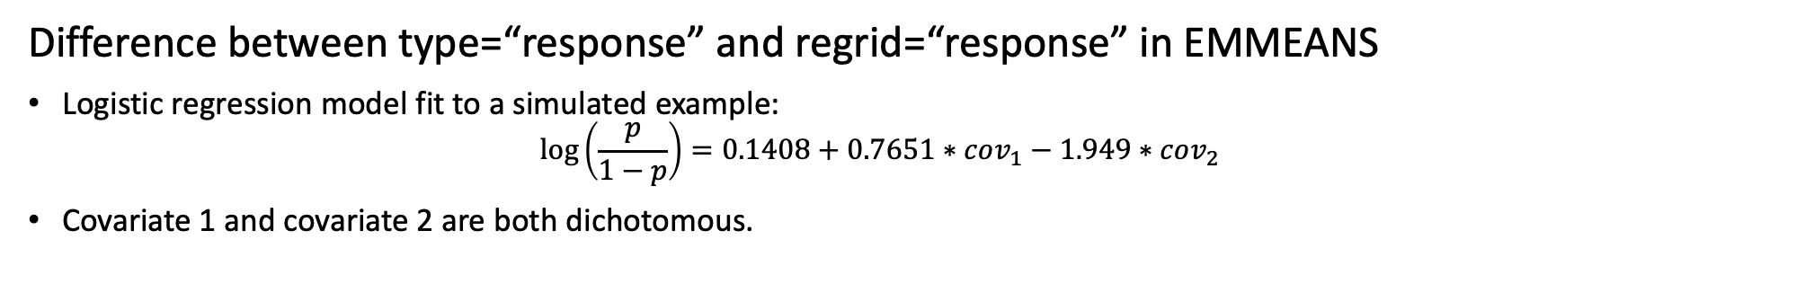
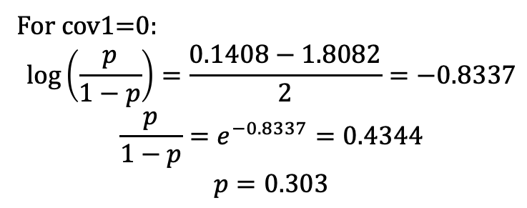
Difference between type=“response” and regrid=“response” in EMMEANS
Logistic regression model fit to a simulated example:
$$\log\left(\frac{p}{1−p}\right)=0.1408+0.7651∗cov_{1}−1.949∗cov_{2}$$
Covariate 1 and covariate 2 are both dichotomous.
Covariate 1 | Covariate 2 | Predictions on the link (logit) scale | Predictions on the response scale
0 | 0 | 0.1408 | 0.5352
0 | 1 | -1.8082 | 0.1409
1 | 0 | 0.9059 | 0.7122
1 | 1 | -1.0431 | 0.2605
When use the option regrid=“response”, the predictions are already on the response scale so that the EMMs will be the arithmetic means of those response-scale predictions
(0.5352+0.1409)/2=0.338
(0.7122+0.2605)/2=0.486
With ⁠type = "response"⁠, EMMs are computed by averaging together predictions on the link scale and then back-transforming to the response scale.
For cov1=0:
$$\log\left(\frac{p}{1−p}\right)=\frac{0.1408−1.8082}{2}=−0.8337$$
$$\frac{p}{1−p}=e^{−0.8337}=0.4344$$
$$p=0.303$$

Slide 19
Adjusted proportions in SAS vs R

Slide 20
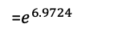
EMMEANS (R)
SAS
 |  | Estimates |  |  |  |  | Contrast
 | Weights= | Source | Prob | SE | Lower CI | Upper CI | Estimate | SE | Z | P
Default (on the link scale) | Equal | Non-skim | -0.86 | 2.10 | -4.97 | 3.26 | 6.97 | 4.31 | 1.62 | 0.1053
 |  | Skim | 6.11 | 4.11 | -1.95 | 14.18
 | Prop | Non-skim | -0.85 | 1.73 | -4.24 | 2.53 | 6.97 | 4.31 | 1.62 | 0.1053
 |  | Skim | 6.12 | 3.86 | -1.45 | 13.68
 | Estimates |  |  |  |  | Contrast
 | source | Estimate | SE | CI lower | CI upper | Estimate | SE | CI lower | CI upper | P
Genmod lsmeans | non-skim | -0.8575 | 2.0994 | -4.9723 | 3.2572 | 6.9724 | 4.3057 | -1.4666 | 15.4114 | 0.1054
 | skim | 6.1149 | 4.1139 | -1.9483 | 14.1780 | 6.9724 | 4.3057 | -1.4666 | 15.4114 | 0.1054
Genmod lsmeans om | non-skim | -0.8549 | 1.7258 | -4.2375 | 2.5276 | 6.9724 | 4.3057 | -1.4666 | 15.4114 | 0.1054
 | skim | 6.1175 | 3.8601 | -1.4482 | 13.6832 | 6.9724 | 4.3057 | -1.4666 | 15.4114 | 0.1054
Type= “response” | Equal | Non-skim | 0.298 | 0.439 | 0.0069 | 0.963 | 1067 | 4593 | 1.62 | 0.1053
 |  | Skim | 0.998 | 0.009 | 0.1249 | 1.000
 | Prop | Non-skim | 0.298 | 0.361 | 0.0142 | 0.926 | 1067 | 4593 | 1.62 | 0.1053
 |  | Skim | 0.998 | 0.008 | 0.1904 | 1.000
Genmod lsmeans ilink | non-skim | 0.2979 | 0.4391 | 0.006880 | 0.9629 | 6.9724 | 4.3057 | -1.4666 | 15.4114 | 0.1054
Genmod lsmeans ilink ª | skim | 0.9978 | 0.009051 | 0.1247 | 1.0000 | 6.9724 | 4.3057 | -1.4666 | 15.4114 | 0.1054
Genmod lsmeans ilink om | non-skim | 0.2984 | 0.3613 | 0.01424 | 0.9261 | 6.9724 | 4.3057 | -1.4666 | 15.4114 | 0.1054
Genmod lsmeans ilink omª | skim | 0.9978 | 0.008470 | 0.1903 | 1.0000 | 6.9724 | 4.3057 | -1.4666 | 15.4114 | 0.1054
=$e^{6.9724}$
Regrid= “response” | Equal | Non-skim | 0.367 | 0.401 | -0.419 | 1.15 | 0.627 | 0.339 | 1.57 | 0.1163
 |  | Skim | 0.994 | 0.019 | 0.958 | 1.03
 | Prop | Non-skim | 0.374 | 0.3133 | -0.24 | 0.988 | 0.619 | 0.314 | 1.974 | 0.0484
 |  | Skim | 0.994 | 0.0194 | 0.956 | 1.032
Margins macro | non-skim | 0.4477 | 0.03483 | 0.3794 | 0.5160 | 0.2865 | 0.1476 | -0.00289 | 0.5758 | 0.0523
 | skim | 0.7341 | 0.1420 | 0.4559 | 1.0124 | 0.2865 | 0.1476 | -0.00289 | 0.5758 | 0.0523
Regrid=“response” in R does not match any value from SAS estimates because it uses the mean of continuous variable to predict the model, then gets the estimates. The “alternative” regrid method has the same estimates as Margins macro in SAS.
 |  | Estimate
Alternative Regrid method | Non-skim | 0.448
 | Skim | 0.734
Notes:
Default

Slide 21
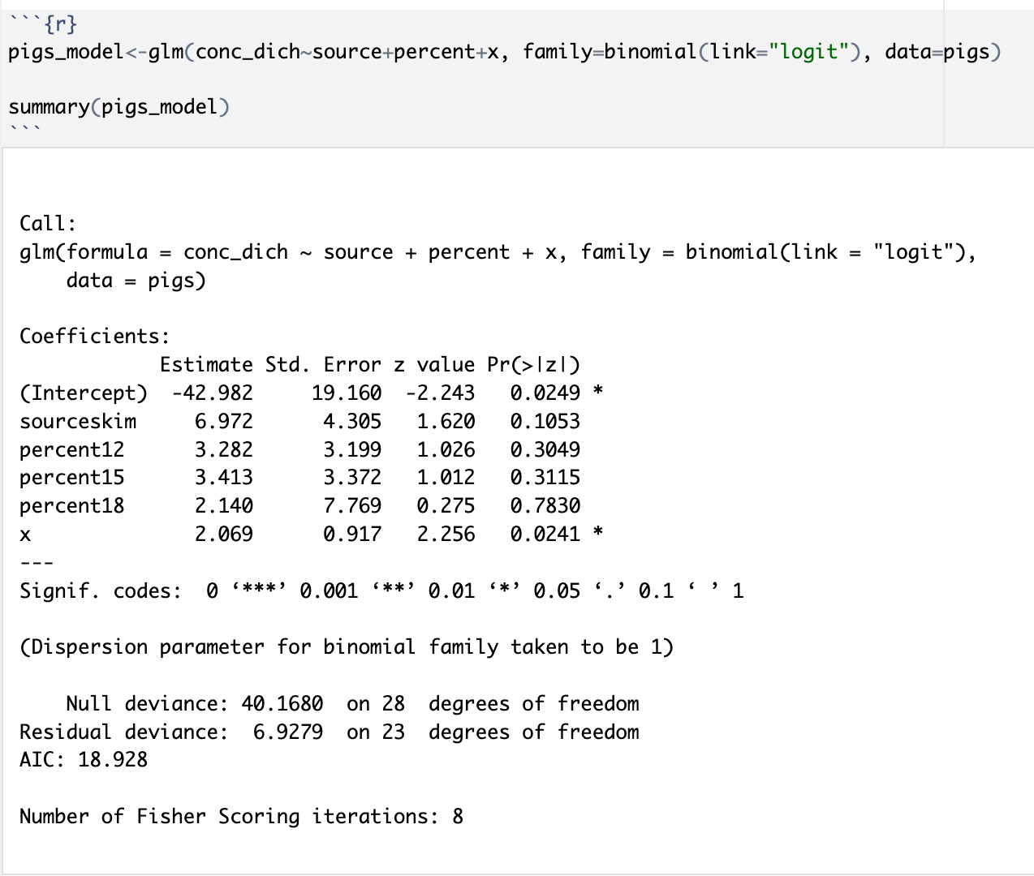
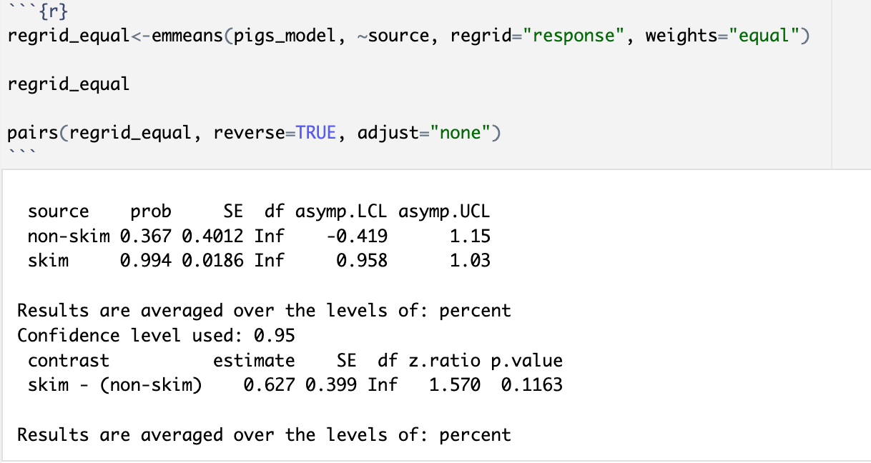
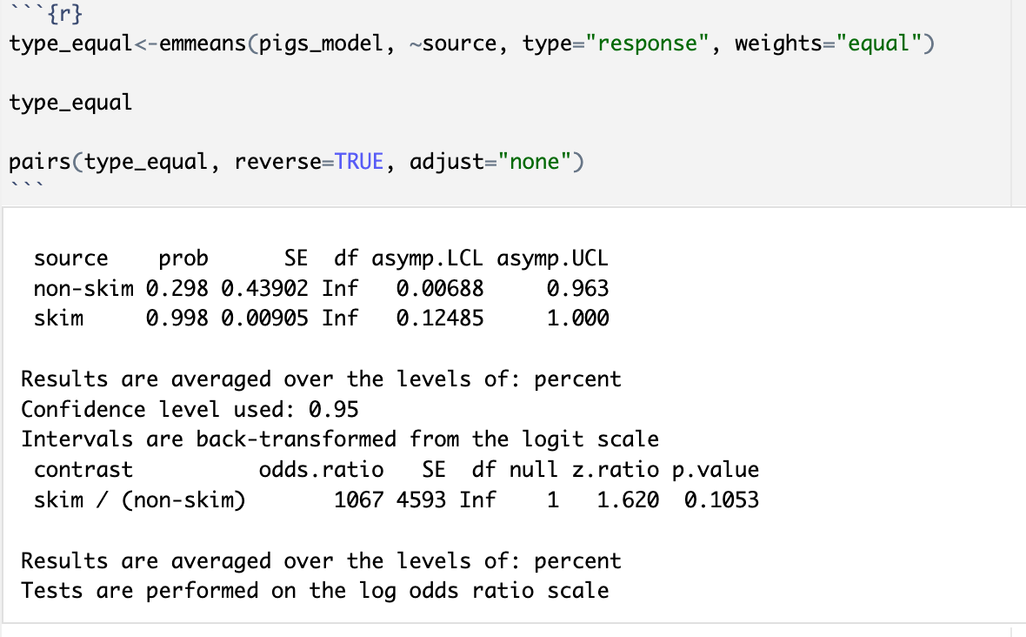
R Codes
Regression
EMMEANS and Contrast
EMMEANS Output
Contrast Output
EMMEANS Output
Contrast Output

Slide 22
EMMEANS (R) vs. SAS
By default estimates from EMMEANS are on the logit scale, which have the same values as Genmod lsmeans in SAS when the weights option is set to “equal” in EMMEANS. The addition of om option in SAS equates weights=“proportional” in EMMEANS. The resulting contrasts are also on the logit scale for both EMMEANS and Genmod.
When type=“response” is used in EMMEANS, the estimates are back-transformed from logit scale, which are the same as Genmod lsmeans with ilink in SAS. But the contrasts from both R and SAS are still on the logit scale, with the contrast from EMMEANS being exponentiated from logit scale.
The atmeans option in the Margins macro provides same adjusted proportion estimates as ilink but then does the contrast test on the risk difference scale (rather than the log odds scale)
When regrid=“response” is used in EMMEANS, the estimates are on the response scale. As described on slide 16 these are different from type = “response” because here the mean is taken AFTER back transforming.
NOTE, the regrid = “response” results are different from Margins macro in SAS when there’s a continuous predictor involved because EMMEANS backtransforms using the mean of the continuous predictor, whereas Margins macro uses the observed values of all continuous predictor to backtransform and get the estimates. That’s why the “alternative regrid method”, where observed values of continuous predictor are used, has the same estimates as Margins macro in SAS.

Slide 23
Alternative regrid method --Using observed values of continuous variable to predict outcome
observation | prediction | source | x | percent
1 | 1.76e-03 | skim | 14.3 | 9
2 | 5.02e-05 | skim | 12.6 | 9
3 | 9.94e-01 | skim | 18.3 | 12
4 | 2.63e-01 | skim | 15.3 | 12
5 | 9.72e-01 | skim | 17.5 | 12
6 | 1.00e+00 | skim | 19.7 | 15
7 | 4.26e-01 | skim | 15.6 | 15
8 | 5.94e-02 | skim | 15.0 | 18
9 | 6.47e-01 | skim | 16.7 | 18
10 | 8.95e-01 | skim | 17.4 | 18
11 | 1.00e+00 | skim | 21.9 | 9
12 | 9.43e-01 | skim | 18.8 | 9
13 | 9.25e-02 | skim | 16.3 | 9
14 | 1.00e+00 | skim | 21.0 | 12
15 | 1.00e+00 | skim | 20.4 | 12
16 | 1.00e+00 | skim | 22.3 | 12
17 | 1.00e+00 | skim | 20.7 | 15
18 | 9.97e-01 | skim | 18.6 | 15
19 | 1.00e+00 | skim | 21.7 | 15
20 | 1.00e+00 | skim | 22.0 | 18
21 | 9.78e-01 | skim | 19.2 | 9
22 | 1.22e-02 | skim | 15.3 | 9
23 | 8.79e-02 | skim | 16.3 | 9
24 | 1.00e+00 | skim | 20.7 | 12
25 | 1.00e+00 | skim | 24.4 | 12
26 | 9.22e-01 | skim | 17.0 | 12
27 | 1.00e+00 | skim | 30.6 | 15
28 | 1.00e+00 | skim | 20.9 | 15
29 | 1.00e+00 | skim | 28.8 | 18
 | prediction | source | x | percent
1 | 1.65e-06 | non-skim | 14.3 | 9
2 | 4.71e-08 | non-skim | 12.6 | 9
3 | 1.39e-01 | non-skim | 18.3 | 12
4 | 3.35e-04 | non-skim | 15.3 | 12
5 | 3.13e-02 | non-skim | 17.5 | 12
6 | 7.72e-01 | non-skim | 19.7 | 15
7 | 6.95e-04 | non-skim | 15.6 | 15
8 | 5.92e-05 | non-skim | 15.0 | 18
9 | 1.72e-03 | non-skim | 16.7 | 18
10 | 7.90e-03 | non-skim | 17.4 | 18
11 | 9.07e-01 | non-skim | 21.9 | 9
12 | 1.52e-02 | non-skim | 18.8 | 9
13 | 9.55e-05 | non-skim | 16.3 | 9
14 | 9.77e-01 | non-skim | 21.0 | 12
15 | 9.31e-01 | non-skim | 20.4 | 12
16 | 9.99e-01 | non-skim | 22.3 | 12
17 | 9.66e-01 | non-skim | 20.7 | 15
18 | 2.66e-01 | non-skim | 18.6 | 15
19 | 9.95e-01 | non-skim | 21.7 | 15
20 | 9.90e-01 | non-skim | 22.0 | 18
21 | 3.95e-02 | non-skim | 19.2 | 9
22 | 1.16e-05 | non-skim | 15.3 | 9
23 | 9.04e-05 | non-skim | 16.3 | 9
24 | 9.60e-01 | non-skim | 20.7 | 12
25 | 1.00e+00 | non-skim | 24.4 | 12
26 | 1.10e-02 | non-skim | 17.0 | 12
27 | 1.00e+00 | non-skim | 30.6 | 15
28 | 9.73e-01 | non-skim | 20.9 | 15
29 | 1.00e+00 | non-skim | 28.8 | 18
 | Mean(prediction)
Non-skim | 0.448
Skim | 0.734
Which has the same estimate with Margins macro from SAS…
 | Estimates |  |  |  |  | Contrast
 | source | Estimate | SE | CI lower | CI upper | Estimate | SE | CI lower | CI upper | P
Margins macro | non-skim | 0.4477 | 0.03483 | 0.3794 | 0.5160 | 0.2865 | 0.1476 | -0.00289 | 0.5758 | 0.0523
 | skim | 0.7341 | 0.1420 | 0.4559 | 1.0124 | 0.2865 | 0.1476 | -0.00289 | 0.5758 | 0.0523

Slide 24
SAS %margins macro - Intro
Help and download at https://support.sas.com/kb/63/038.html.
Included in SAS TS1M8, otherwise needs an %include statement.
The Margins macro fits the specified generalized linear or GEE model and estimates predictive margins and/or average marginal effects for variables in the model. Differences and contrasts of predictive margins and average marginal effects with confidence limits are also available. Margins and effects can be estimated at specified values of other model variables or at computed values such as means or medians.

Slide 25
SAS %margins macro – How it works
%margins(
data = pigs,
response = conc_dich,
roptions=event="High",
class = source ppercent,
classgref = FIRST,
model = source ppercent x,
dist = binomial,
link = logit,
margins = source,
options = atmeans cl diff reverse);
By default, a complete replicate of the data set is created for each combination of levels of the margins= variable(s) in the data set. Each replicate fixes the variables for all observations at one combination of levels. The predictive margin for each combination is computed as the average predicted value in that combination's replicate. Similarly, the average marginal effect is the average of the marginal effects computed for the observations in that combination's replicate.

Slide 26
SAS %margins macro - ATMEANS
atmeans: compute predictive margins at the means of all other model variables except for those specified in at=. For marginal effects, all variables other than those in margins= or at= are fixed at their means. For a class= variable, its overall observed proportions are used as values for the dummy variables that represent the variable in the model. Same as LSMEANS OM option.
Fixed values for all variables means it gives a marginal mean, which has same estimates and SEs as genmod lsmeans with ILINK and OM options. But it does give contrast estimates as a risk difference.
Note: If you have sampling weights or frequency weights in your model, it does not use them when computing proportions for class variables for aggregated data.

Slide 27
Comparison of LSMEANS ilink to Margins Macro
 |  | Estimate | SE | LowerCL | Upper CL | Contrast | SE | lowerCL | upperCL | P-value
Genmod lsmeans ilink | non-skim | 0.2979 | 0.4391 | 0.006880 | 0.9629 | 6.9724 | 4.3057 | -1.4666 | 15.4114 | 0.1054
Genmod lsmeans ilink ª | skim | 0.9978 | 0.009051 | 0.1247 | 1.0000 | 6.9724 | 4.3057 | -1.4666 | 15.4114 | 0.1054
Genmod lsmeans ilink om | non-skim | 0.2984 | 0.3613 | 0.01424 | 0.9261 | 6.9724 | 4.3057 | -1.4666 | 15.4114 | 0.1054
Genmod lsmeans ilink omª | skim | 0.9978 | 0.008470 | 0.1903 | 1.0000 | 6.9724 | 4.3057 | -1.4666 | 15.4114 | 0.1054
Margins macro | non-skim | 0.4477 | 0.03483 | 0.3794 | 0.5160 | 0.2865 | 0.1476 | -0.00289 | 0.5758 | 0.0523
 | skim | 0.7341 | 0.1420 | 0.4559 | 1.0124 | 0.2865 | 0.1476 | -0.00289 | 0.5758 | 0.0523
Margins macro atmeans | non-skim | 0.2984 | 0.3613 | -0.4098 | 1.0065 | 0.6994 | 0.3618 | -0.00976 | 1.4086 | 0.0532
Margins macro atmeans^{b} | skim | 0.9978 | 0.008470 | 0.9812 | 1.0144 | 0.6994 | 0.3618 | -0.00976 | 1.4086 | 0.0532

Slide 28
Any Questions

Slide 29
Reference
https://cran.r-project.org/web/packages/emmeans/index.html
https://stats.stackexchange.com/questions/610912/emmeans-weights-for-unbalanced-groups-factors
https://github.com/rvlenth/emmeans/issues/451
https://stats.stackexchange.com/questions/510862/is-least-squares-means-lsmeans-statistical-nonsense/510923 - 510923
https://stats.stackexchange.com/questions/502010/comparing-emmeans-to-ggeffect-default-weights/502027#502027

